Slide 1

Airport Restaurant Final Report
Shaun Pritchard - Module 6 - QMB4000
Full Code atached in asignment jupyter notebook

Slide 2
Key Points
We will be looking at Airport restaurant dataset to find correlations and trends based requested by the CEO to answer these questions:
The average delayed arrival flight times
The average delayed arrival flight time based on each airport location
The origin and destination airports that have the longest delayed flight times on average
The average delay in departure time per airport by starting destination

Slide 3
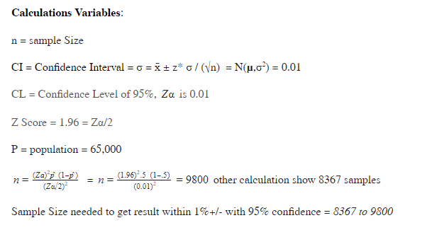
Data Dimensionality & Subset Sample
In this project I used the final flight data dataset subset to run inferences and plots. I used applied statistic method to select the size of my subset using a confidence sampling distribution to select 10,000 rows of data. This selection of data would precede me to have 95% confidence within a margin of +/-1% accuracy in inferring the best results for this report.

Slide 4
Preprocessing Data
Initially I accessed the dataset using the Python framework and ran several tests to check the integrity of the data and to find any missing values or inconsistencies.
I then replaced NULL values with mean bivariate feature values
I Then used descriptive statistic techniques to clean and process the data set for further inferences

Slide 5
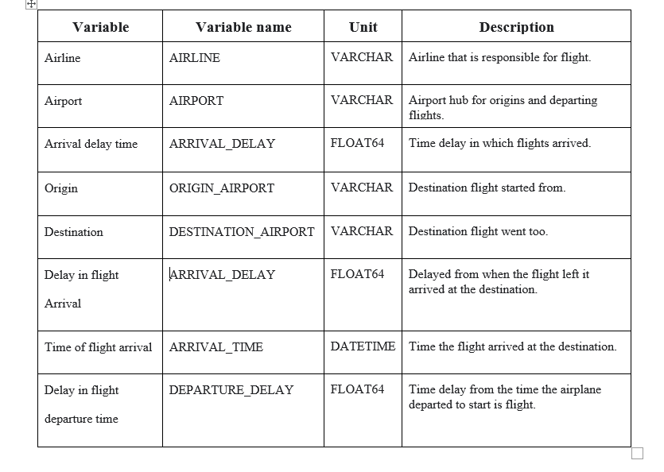
Dat Dictionary
I created a quick Data Dictionary for refence to data to help the CEO Understand the variables of the data inferences.

Slide 6
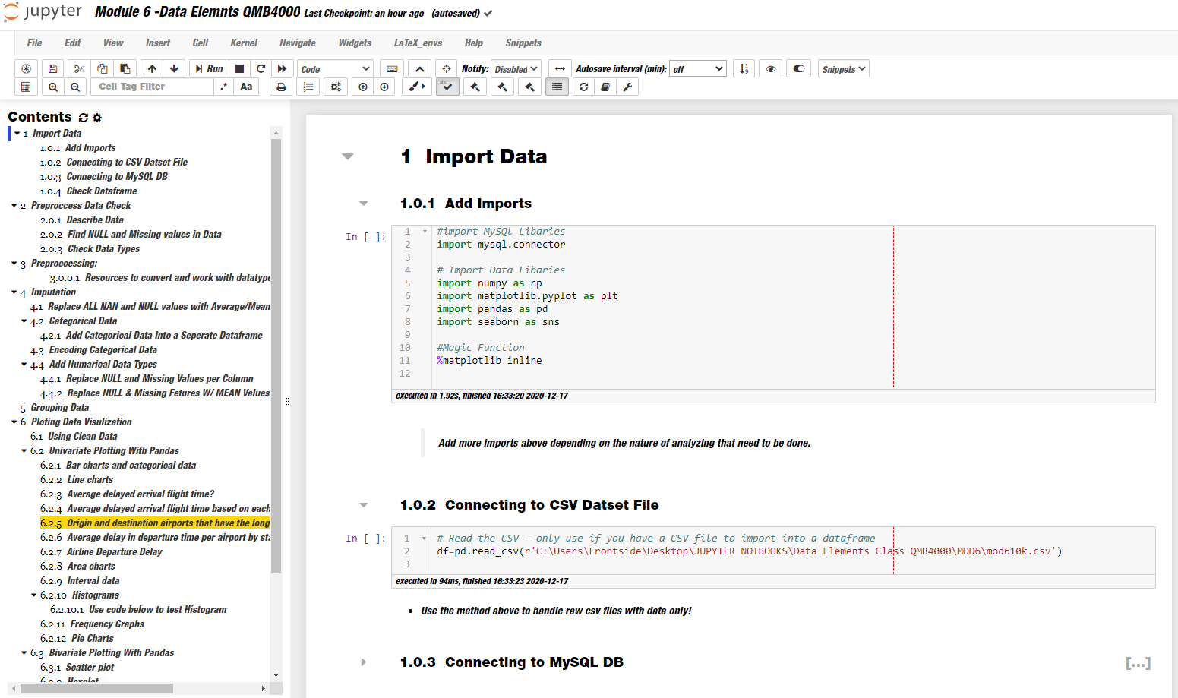
Python workflow
Connected to MySQL database server to run inferences on data.

Slide 7
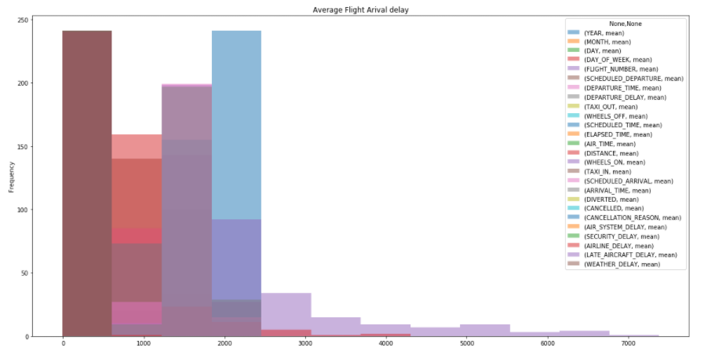
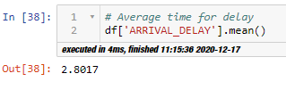
Q1. What is the Average delayed arrival flight time?
Data Results
Code:
Essentially the average delay in flight times based on units provided in the data set is mean time of 2.80 a median time value of -4.0.

Slide 8
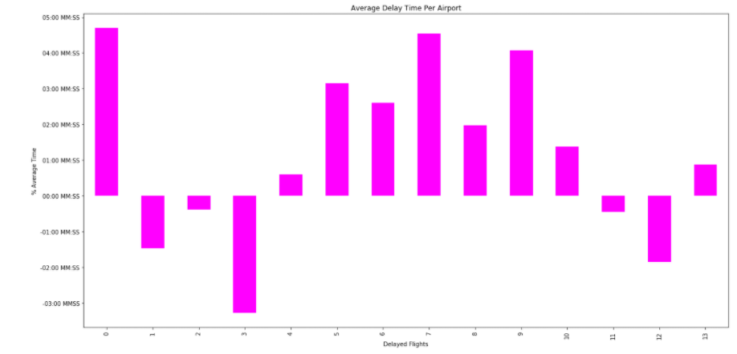

Q1. The average delayed arrival flight time based on each airport location
Data Results
Code:
Using techniques with grouping the AIRPORT variable with AVERAGE_DELAY variable I was able to determine the average delay time per airport was 2.94 (HH:MM:SS)

Slide 9
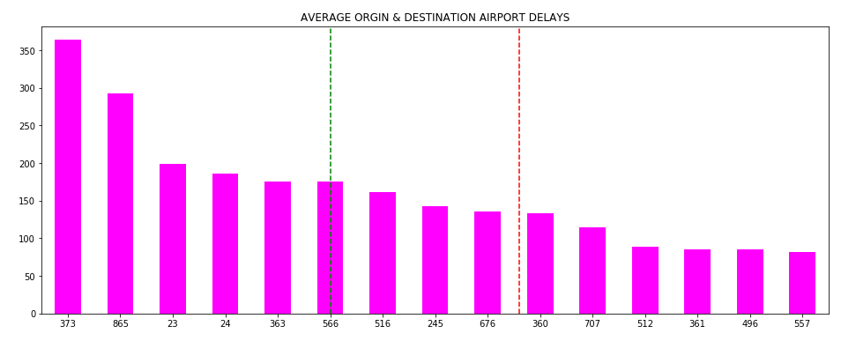
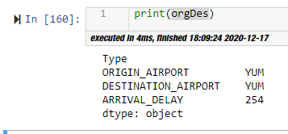
Q2 The origin and destination airports that have the longest delayed flight times on average
Data Results
Code Screenshot
Description:
Set 2 columns in a vector to determine the variance for each set of data and apply the average times in delays to and from each destination to get the results of this report AVG Airport = YUM, AVG Delay = 254

Slide 10
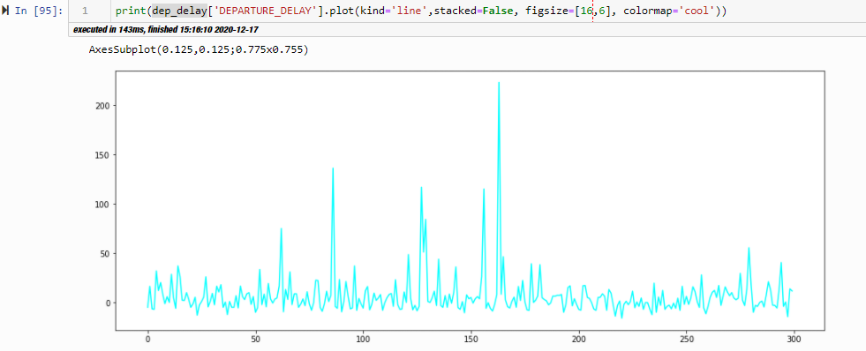
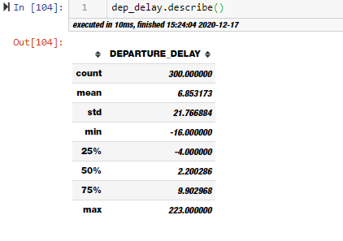
Q3 Average delay in departure time per airport by starting destination
Data Results
Code Screenshot
Description:
I grouped the ORGIN_AIRPORT variable to the time in DEPARTURE_DELAY variable with a calculated mean to average . MEAN = 6.9

Slide 11
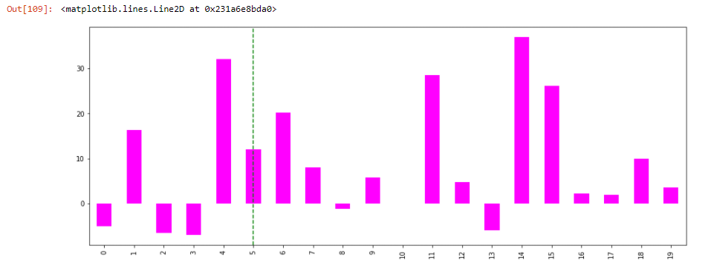
Q3 Average delay in departure time per airport by starting destination
Data Results
Code Screenshot
Description:
Visualization #2 for Bar chart average delay per destination.

Slide 12
Conclusion:
Data shows us:
The average delayed arrival flight time is = 2.8 (hh:mm:ss) means delay time.
The average delayed arrival flight time based on each airport location = 2.9 (hh:mm:ss) means delay time.
The origin and destination airports that have the longest delayed flight times on average
The average delay in departure time per airport by starting destination = 6.9 (hh:mm:ss) means delay time.

